Slide 1
Edgebrook Club Current Club Guidelines Summer 2021 All information is subject to change throughout the summer! Please continue to check edgebrookclub.org for updates to this document. Updated and/or New slides are marked with a
Updated 8/24/2021

Slide 2
Symptoms of COVID-19
Fever
Cough
Short of breath or difficulty breathing
Fatigue
Muscle or body aches
Headache
New loss of taste or smell
Sore throat
Congestion or runny nose
Nausea or vomiting
Diarrhea

Slide 3
General Screening
Before joining us for fun at Edgebrook, you need to answer no to all of the following questions:
Have you been diagnosed with COVID-19 and have not recovered or are still within the required 14-day quarantine?
Have you started to exhibit any symptoms consistent with COVID-19 within the past 10 days?
Have you had close contact with a person that has or is suspected to have COVID-19 within the past 14 days?
If you cannot answer “no” to all of these questions, we ask that you not come into the facility today. ☺

Slide 4
Follow us on Instagram @edgebrookclub !
Download the Edgebrook Swim & Tennis Club app from Apple Store or Google Play Store!
You can manage your account, manage reservations and register for programming all in the app! The Edgebrook app is the BEST place to manage your Edgebrook experience!

Slide 5
Mask Policies
Masks are required in all indoor areas of the club (this includes the restrooms and during entrance/exit of facilities).
Masks are also required regardless of vaccination status during all indoor programming that involves juniors (ie, Junior Tennis).

Slide 6
General Guidelines for Edgebrook Club
Utilize calling or emailing for customer service questions
Bring full water bottles with you
Hand sanitizer will be available on-site
Please limit the volume of your belongings on the property and take all your belongings with you - there will be limited lost and found. Most items left on the property will be disposed of immediately.
Members should utilize Club Automation, email and phone for all needs.
We do not accept cash payments and do not have cash on site.
Front office staff will be available 30 minutes before the first tennis court time, but no earlier than 8am. Front office staff will end their shift 30 minutes prior to the last tennis court time ending.
Members who do not follow club guidelines will be asked to leave the facility.

Slide 7
Guest Policies Equity & Summer Family Memberships
Swimming
There are no physical guest passes
Three non-member/guest is permitted per day for a pool reservation
Paying for a guest can happen in two ways:
Using a Seasonal Guest Pass
Good for one guest per visit - $50+ tax for the summer/non-refundable
Paying for a guest each time they visit - $5+ tax per visit
Guest fee is charged to the member’s account or must be paid using the member’s card on file (dependent on membership type)
Tennis
Guests are permitted for court reservations
Liability waivers must be completed
Guest fee is charged to the member’s account or must be paid using the member’s card on file (dependent on membership type)
Members should email frontdesk@edgebrookclub.org with the First Name, Last Name and email address for all tennis guests. The sooner this is done, the quicker check-in is for the tennis court.

Slide 8
Guest Policies Junior Memberships
Junior Swim Membership
No guests/non-members allowed, but one member can be added to each pool reservation made
No tennis privileges
Junior Tennis Membership
Swimming
There are no physical guest passes
One non-member/guest is permitted per day for a pool reservation
Guest fee is charged to the member’s account each time they visit ($5+ tax per visit)
Tennis
Guests are permitted for court reservations
Liability waivers must be completed
Guest fee is charged to the junior tennis member’s account
Members should email frontdesk@edgebrookclub.org with the First Name, Last Name and email address for all tennis guests. The sooner this is done, the quicker check-in is for the tennis court.
Parents playing with their junior are considered guests and a guest fee is applicable.

Slide 9
General Pool Reservation Info (1 of 2)
Reservations are for the entire membership and only one reservation per family membership is permitted per day
Pool reservations can also include one non-member/guest OR one member that is not on your membership.
Reservations are for 1 hour, 50 minutes only. Your reservation in our system will say 2 hours. The last 10 minutes of the reservation is for clearing the facility and additional facility safety checks.
Only one reservation per day per membership (not per member). Reservations can be made up to 6 days in advance.
There is no charge for pool reservations, however missed pool reservations will result in a $15 no-show fee.
Remaining Pool Hours for the season are as follows:
Monday August 23rd: 12 p.m. - 8 p.m.
Tuesday August 24th: 12 p.m. - 8 p.m.
Wednesday August 25th: 12 p.m. - 8 p.m.
Thursday August 26th: 12 p.m. - 8 p.m.
Friday August 27th: 12 p.m. - 8 p.m.
Saturday August 28th: 10 a.m. - 8 p.m.
Sunday August 29th: 10 a.m. - 8 p.m.
Monday August 30th - Friday September 3rd: Pool Closed
Saturday September 4th: 10 a.m. - 8 p.m.
Sunday September 5th: 10 a.m. - 8 p.m.
Monday September 6th (Labor Day): 10 a.m. - 6 p.m.
Tuesday September 7th - Friday September 10th: Pool Closed
Saturday September 11th: 1 p.m. - 5 p.m. (No Pool Reservations Needed)
Sunday September 12th: 1 p.m. - 5 p.m. (No Pool Reservations Needed)
​Monday September 13th: Pool Closed For Season
Please arrive no more than 10 minutes prior to your reservation.
Sample schedule:
Reservation from Noon-2pm
Pool open for swim from noon-1:45pm
Pool closed to swimmers at 1:45pm

Slide 10
General Pool Reservation Info (2 of 2)
Reservations should be cancelled at least 24 hours in advance. At this time, we are not charging fees for cancellations. We are asking all members to be mindful of others when booking and cancelling reservations so that all members can enjoy our facility.
Pool cancellations can be completed online via the club automation system. Cancellations less than 24 hours in advance, must be emailed to frontdesk@edgebrookclub.org.
Pool furniture is separated on the pool deck; please only use one reserved area so that we can maintain distance between households for those who wish to keep their distance as a courtesy.
Pool toys are permitted as long as they do not interfere with the lifeguard’s ability to keep members safe and allow for swimmers to maintain distancing.
The kiddie pool area is limited to swimmers 6 and under.
Lap lanes are available during any reservation upon request.

Slide 11
Swim Guest Policy Examples
Jane Doe makes a reservation for noon. The reservation is good for the entire family that is listed on her membership (she can bring in all of her kids during the reservation time) and no other members on her account can make a separate reservation for the same day for pool use.
Jane Doe makes a reservation for noon. The reservation is good for the entire family that is listed on her membership (she can bring in all of her kids during the reservation time). Mary Snow is also a member at the club and friends with Jane’s child – Jane invites Mary to swim during their noon reservation. This is permitted.
Jane Doe makes a reservation for noon. The reservation is good for the entire family that is listed on her membership (she can bring in all of her kids during the reservation time). Fran Snow is a non-member at the club and friends with Jane’s child – Jane invites Fran to swim during their noon reservation. Jane is responsible for Fran while on the property and Fran’s guest fee is charged to Jane – either to her membership account, to her cc on file OR with use of Jane’s Seasonal Guest Pass.
Jane Doe makes a reservation for noon. The reservation is good for the entire family that is listed on her membership (she can bring in all of her kids during the reservation time). Mary and Jack Snow are also a members at the club and friends with Jane’s child – Jane invites Mary and Jack to swim during their noon reservation. This is NOT permitted; only one additional person is allowed during the reservation time.
Jane Doe makes a reservation for noon. The reservation is good for the entire family that is listed on her membership. Jane’s partner is unable to come and enjoy the pool at noon. Mary and Jack Snow are also a members at the club and friends with Jane; Jane invites Mary and Jack to swim during their noon reservation. This is NOT permitted; only one additional person is allowed during the reservation time.

Slide 12
General Pool Info
Check-in for pool reservations will be at the loading zone gate near the cabana.
Food (no glass) is permitted on the pool deck in the designated reservation areas
If it is impractical to do so and a life is believed to be in danger, lifeguards will not follow the mask or physical distancing guidelines. This could potentially increase your risk of COVID-19 infection.
Lifeguards needs to be focused on monitoring patrons for water-safety-related risks and should not be asked to enforce distancing or COVID-19 related policies that would detract from lifesaving duties. We will have other staff on the property that will monitor distancing, but ask that all of our members be sure they are keeping everyone safe.
We anticipate having opportunities for everyone to enjoy the pool this summer! While some time slots might be busier than others, we feel like our reservation system will give everyone a chance to come and swim – even if their first time choice isn’t available.

Slide 13
Group Swim Lessons
All lessons programming is open to ONLY members for this summer.
Group lessons registration will open on Wednesday, June 2nd at 9am.
Instructors will be in the water for levels 1-3; Instructors will be out of the water for levels 4-5.
In-water instructors will wear face shields that completely enclose their faces.
Class sizes will be limited to 3 for level 1; 4 for levels 2-3 and 5 for levels 4-5.
For level descriptions, please refer to the swim page on the edgebrookclub.org website.

Slide 14
Swim Team – Program Expectations
If you are feeling sick, you MUST stay home. Coaches will begin the season with clear expectations for the swimmers in their assigned group and start each day with safety reminders.
We urge athletes to arrive and leave in your swimsuit
The Edgebrook Swim team practices rain or shine.
If it is impractical to do so and a life is believed to be in danger, lifeguards and coaches will not follow the mask/face shield or physical distancing guidelines. This could potentially increase risk of COVID-19 infection.
If you have anything you would like to discuss with coaches, we ask that you please email, text or call Coach Laura outside of practice time. Laura Halter, the Edgebrook Head Coach, is available via email at lkthalter@comcast.net.
If your child does not take instruction well and cannot adhere to guidelines while participating in programming at Edgebrook, they will be removed from the programming at your expense. Please, talk with your child about how they can best enjoy their swim team experience.

Slide 15
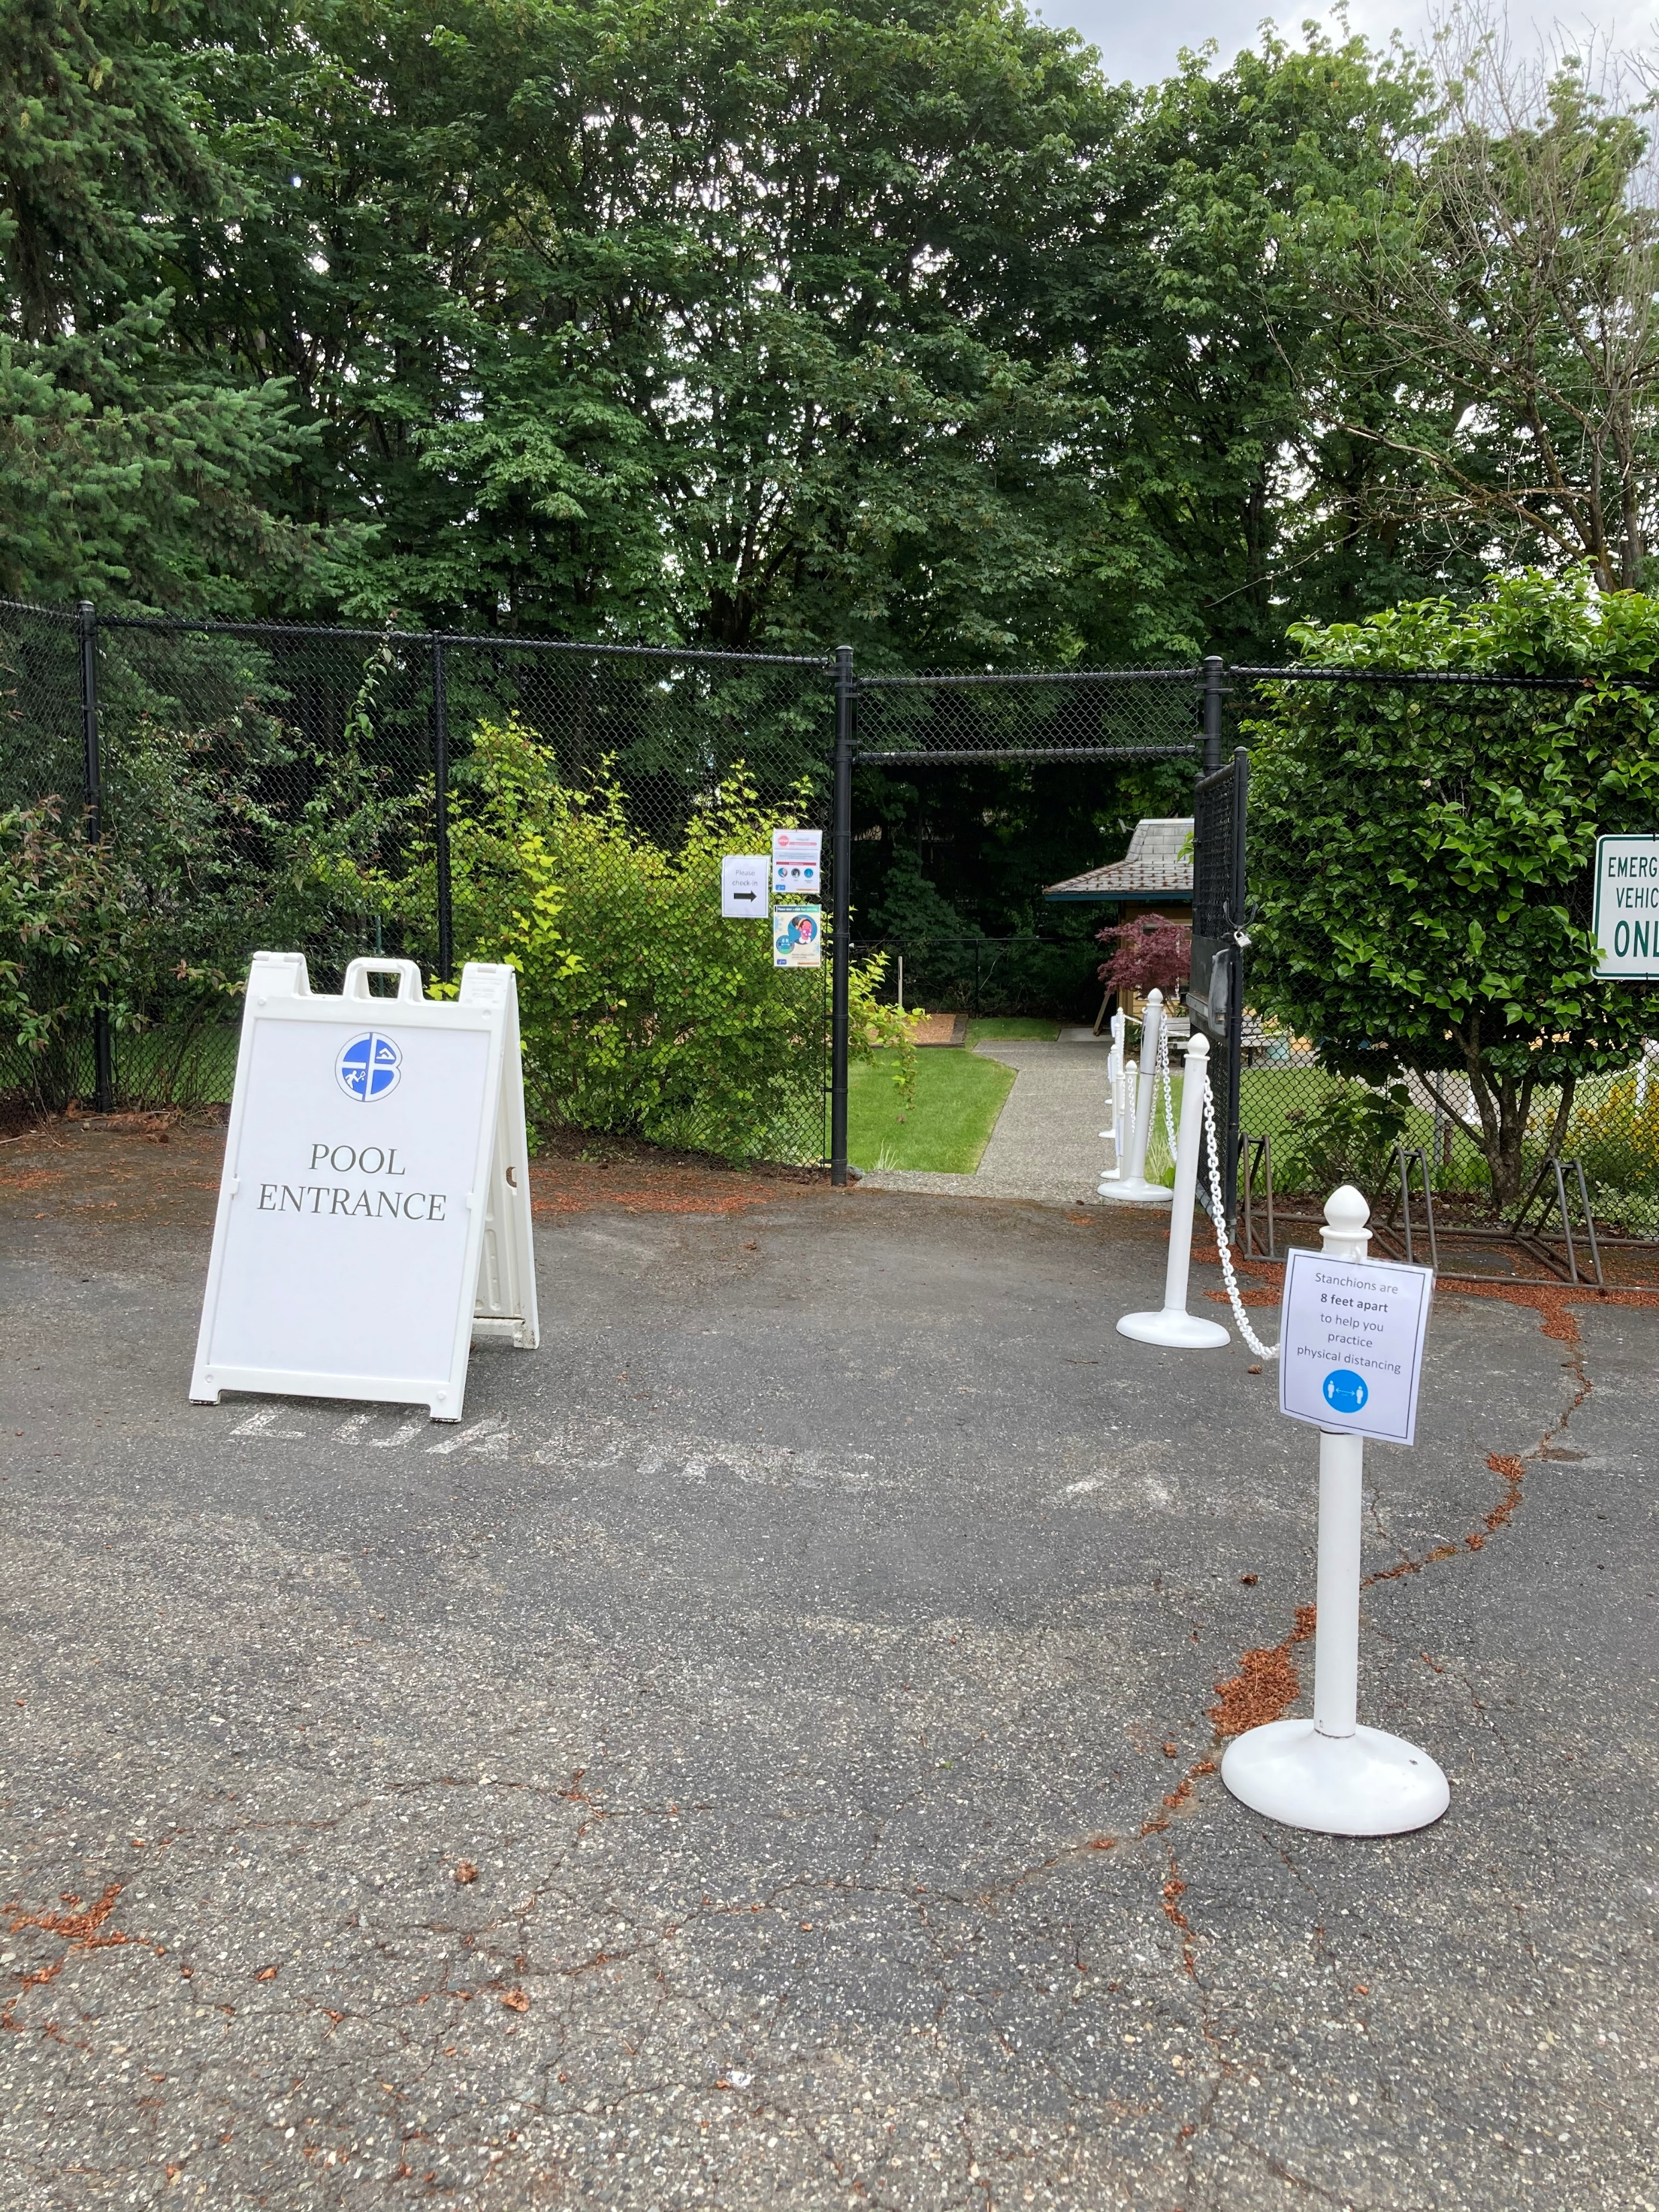
Where to go to check-in: Swim Team All Ages
DO NOT CHECK IN AT THE EDGEBROOK FRONT OFFICE.
Check-in will be through the side gate in front of the cabana starting 5 minutes before your scheduled practice time. Signage is posted for clarity.
Practice times are designed to maximize water time for the athletes and to reduce
Please do not arrive or leave your vehicle more than 5 minutes prior to the start of your scheduled practice time.
The large gate leading into the parking lot will be open and is the exit point for swimmers.
To help with our young swimmers and their families entering and exiting the parking lot, we ask that you park your car and walk your young swimmers toward the gate for check-in.
Please do not circle the lot multiple times.
We want the least amount of automobile traffic for the safety of our young members.

Slide 16
Swim Team What to Bring
What to bring:
Swim Suit (on prior to arrival is suggested)
Cap and goggles (for young swimmers, please have these items on prior to arrival as well for quick start!)
Slip-off shoes
Towel
Optional, but recommended items:
Water bottle, if your swimmer uses one (enough water for the entire practice) – there is no water provided on the pool deck
Parka
Small Bag to hold extra items
There is no lost and found on site. Does your child break goggle straps or caps often? Pack them an extra set to stay in their small swim bag.
The Key:
Make your child self-sufficient while here for practice.

Slide 17
Private Swim Lessons
Private swim lessons are now available. All levels of swimming are welcome to take private lessons.
For private swim lessons, instructors will be wearing masks and face shields for all in-water lessons. We also encourage parents who want to be hands on with their little swimmers to join in on lesson instruction in the water!
All lessons programming is open to ONLY members for this summer.
Swim Lessons participants should enter and exit through the designated pool access points. Signage is posted from the parking lot.
Once you book a lesson, if your settings and email address are entered onto each member of your club automation account, you will get an email confirming reservation and reminders!
No hassle payment. Payment for lessons will occur once the lesson time happens via the credit card on your account. You can correct or adjust your card information via your Club Automation account. Please email frontdesk@edgebrookclub.org to remove a credit card from your account.
All facility guidelines are still applicable during private lessons.
2021 Summer pricing
ranges from $26-$41/30 minutes dependent on the instructor you choose.
Instructor bios are now posted on the Edgebrook website!

Slide 18
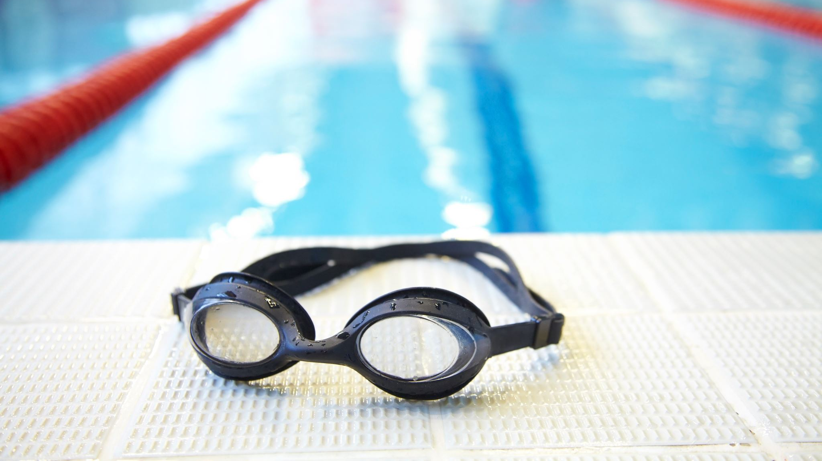
Masters Swim Team
Tuesdays & Thursdays
6/29-7/29
6:15-7:15am
With Coach Laura
Limited to 12 swimmers; No drop-in available
18+ only
$100+ tax
Register via your Club Automation account
REGISTRATION OPENS JUNE 2nd
No experience required; must be able to swim across the pool unaided and comfortable in lap swimming setting

Slide 19
Adult Tennis Options
July/August Doubles Flights
Registration opens June 16th at 8:30am online and closes June 20th at 11:59pm.
Women's Flights:
Monday: 9:30am (4.0+)
Monday: 11:00am (3.5+)
Monday: 6:00pm (3.5+)
Monday: 7:30pm (2.5-3.0)
Wednesday: 9:30am (2.5-3.0)
Open Flights:
Friday: 8:00am (Ladies 3.5+, Men 3.0-3.5)
Men's Flights:
Tuesday: 7:30pm (3.0 & 3.5) (mostly 3.5 & strong 3.0) Tuesday: 9:00pm (3.0 & 3.5) (mostly 3.0 & 3.5s not at 7:30pm)
Wednesday: 7:30pm (4.0 & 3.5) (mostly 4.0 & strong 3.5)
Wednesday: 9:00pm (4.0 & 3.5) (mostly 3.5)
For more information on flights, visit our flights webpage: http://www.edgebrookclub.org/flights.html
Group Classes $22+ Tax
Monday
12:30 p.m.: Ladies Singles Strategy (3.5 & Below) with Jaimie
Thursday
7:30 p.m.: Skills & Drills (3.5 & Below) with Sean
7:30 p.m.: Wimbledon (3.5 & Above) with Alex
9 p.m.: U.S. Open (4.0 & Above) with Alex
Friday
11 a.m.: Ladies Singles Strategy (3.5 & Above) with Jaimie
Saturday
9 a.m.: Saturday Smashers (3.0-4.0) with Alex
Sunday
9:30 a.m.: Skills & Drills (3.5 & Below) with Sean

Slide 20
Private Lesson Instruction - Tennis
Lessons are booked directly with the tennis staff
Bios and contact information can be found on our edgebrookclub.org Tennis page.
Our staff do sometimes have full schedules and are unable to accommodate every single member, please be patient if we are unable to make a lesson day and time work that you are requesting if it is popular, or we do not have court space available.

Slide 21
Junior Tennis Program – Levels 2-5 Outdoor Court Expectations
Inclement weather means class is cancelled for the day. We will make the decision to cancel classes at least 45 minutes before its scheduled start time. You will be notified via email and text only. (Have you opted into texts? Please email Frontdesk@edgbrookclub.org if you are not sure.) We will not be able to call all participants.
In this case, class pricing will be pro-rated. Summer members will receive a refund at the end of the week. Equity and Junior Tennis Members will see an adjustment to their charged amount on account.
Please apply sunscreen prior to coming to class.
Because our instructors have tight teaching schedules, between classes, please do not talk or chat with them. If you have anything you would like to discuss, please email the front desk at frontdesk@edgebrookclub.org and we will direct the email to the appropriate instructor.
If your child does not take instruction well while participating in programming at Edgebrook, they will be removed from the programming at your expense. Please, talk with your child about how they can best enjoy their class experience.
If you are feeling sick, you MUST stay home.
Pros will start each week with clear expectations for each court of play and each day with safety reminders
Students will be given ONE warning before parents are contacted and they are removed from the class.

Slide 22
Outdoor Deck and Indoor Viewing Area Socializing
We are continuing work on the outdoor deck with furniture and other pieces being added throughout the upcoming weeks, but the is now open for use.
Use of the deck does not require a reservation, but it is not open for wet bodies/swimmers at this time.
The deck is not large, and we prefer that the number of people on the deck is limited to 12 or less.
The deck and the indoor viewing area close promptly at 11pm. We do not have options YET for closers. Stay tuned!

Slide 23
Where to go for Junior Tennis Levels 2-5
DO NOT CHECK IN AT THE EDGEBROOK FRONT OFFICE.
*See adjacent map for check-in area and exit area*
Check-in will be 5 minutes prior to your scheduled start time; we encourage you to wait in your cars until then.
Exit
Entry and Check-In

Slide 24
Junior Tennis Program – What to Bring
What to bring:
Water bottle (enough water for the entire class) – there is no water provided on the courts
Tennis racquet – we do not have demo racquets on site
Hat/Visor, Sunglasses (Levels 2-5)
Optional, but recommended items for Levels 2-5 ONLY:
Sunscreen for reapplication
Bag WITH hook
A carabiner hook is GREAT! It will allow you to hang your bag on the fence OFF the ground and help us be sure your items are adequately distanced from others.

Slide 25
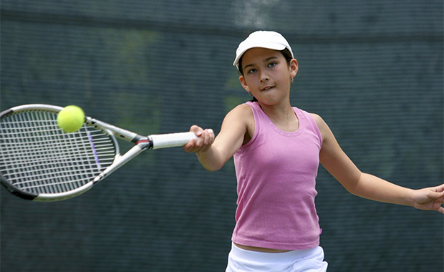
Junior Tennis Program – Level 1 Court Expectations (Indoor Courts)
Masks required on all indoor play during our junior tennis program.
If you are feeling sick, you MUST stay home. Pros will start each week with clear expectations for each court of play and each day with safety reminders
Students will be given ONE warning before parents are contacted and they are removed from the class.
Edgebrook staff will put together similar skills, as possible, on the same court.
Personalities and friendships will also play into groupings to increase enjoyment for those kids who want to be together.
Because our instructors have tight teaching schedules, between classes, please do not talk or chat with them. If you have anything you would like to discuss, please email the front desk at frontdesk@edgebrookclub.org and we will direct the email to the appropriate instructor.
If your child does not take instruction well and cannot adhere to guidelines while participating in programming at Edgebrook, they will be removed from the programming at your expense. Please, talk with your child about how they can best enjoy their class experience.

Slide 26
All office spaces remain staff only
Conference Room
Cabana
While we typically love treats and snacks from our members, we ask that you refrain from bringing those items in until further notice.

Slide 27
Additional EB Staff Measures for your safety
Temperature/health checks upon arrival of all staff
Covid-19 safety training for the staff
Frequent hand washing and limited time in the building for staff
Fully vaccinated staff have the option to not wear a mask upon entry, exit or while moving about the property.
PPE provided for all staff
Sneeze guard at check-in areas
Access to increased supplies as needed to eliminate contamination points for staff
High traffic touchpoints to be sanitized throughout the day

Slide 28
Who to contact? Because we have staff working both in person and remote, we suggest that you reach out via email whenever possible!
Swim Team
swimteam@edgebrookclub.org
Group Swim Lessons Registration
Stefanie@edgebrookclub.org
Reservations
frontdesk@edgebrookclub.org
Tennis Lessons
alex@edgebrookclub.org
jaimie@edgebrookclub.org
sean@edgebrookclub.org
Junior Tennis Registration
ebaccounts@edgebrookclub.org
Billing/Payment Questions
ebaccounts@edgebrookclub.org
General Aquatics
aquatics@edgebrookclub.org
When in doubt – email frontdesk@edgebrookclub.org and we will direct you to the right person!

Slide 29
FOOD TRUCK ALERT!! Jessica’s Unique Bite Burgers
Sunday, May 23rd from Noon-3pm
Open to all members – no pool or tennis reservation needed!

